Slide 1


Group 5

Slide 2
What is Go Nuts?
A competitive networked multiplayer racing game
3-5 players
Simultaneous, symmetric gameplay
PC standalone
Keyboard & Mouse
Approx. 5-6 minutes of desired playtime per round
Males aged 10-15

Slide 3
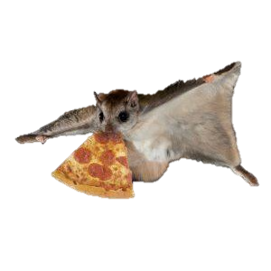
What the players do?
Observe
Streets?
Overall goal:
Obtain 2 nuts before anyone else
Reach the far end of the level
Grab a nut
Return to base
Execute
Decide Path
Decide Method
Rooftops?
Wall jump?
Run?
Grapple?
Notes:
Core game loop:
Observe the level and potential paths through it.
Decide on the optimal path through the map.
Decide the method to achieve that route (ground movement/grapple/glide)
Execute.
Overall goal:
Obtain 3 nuts before anyone else.
Descend the hill
Grab a nut
Return to base

Slide 4
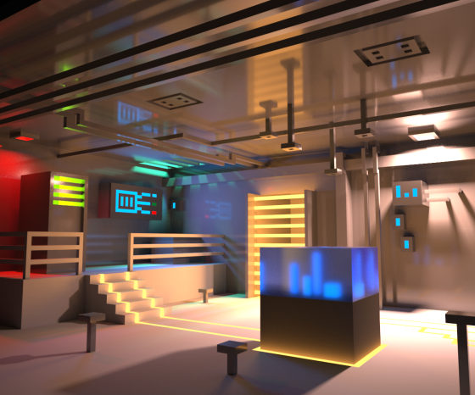
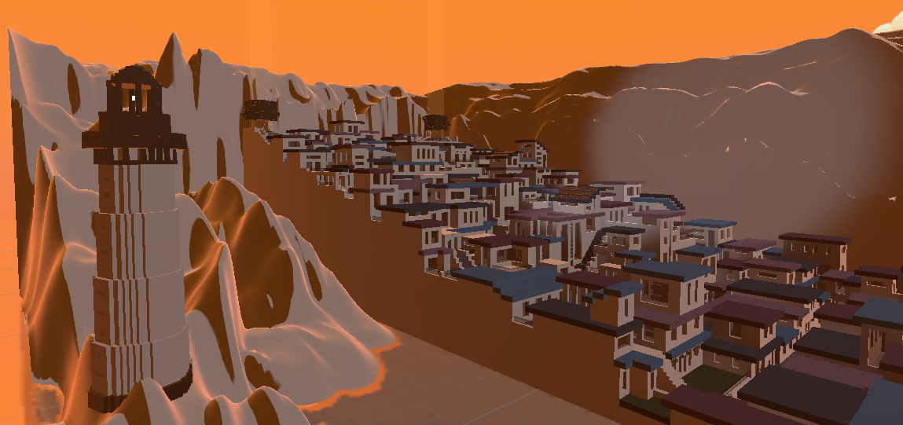


What does it look like?

Slide 5
Feedback
Level too dark
Grappling was difficult and confusing
Goal not clear
Eagle was confusing

Slide 6
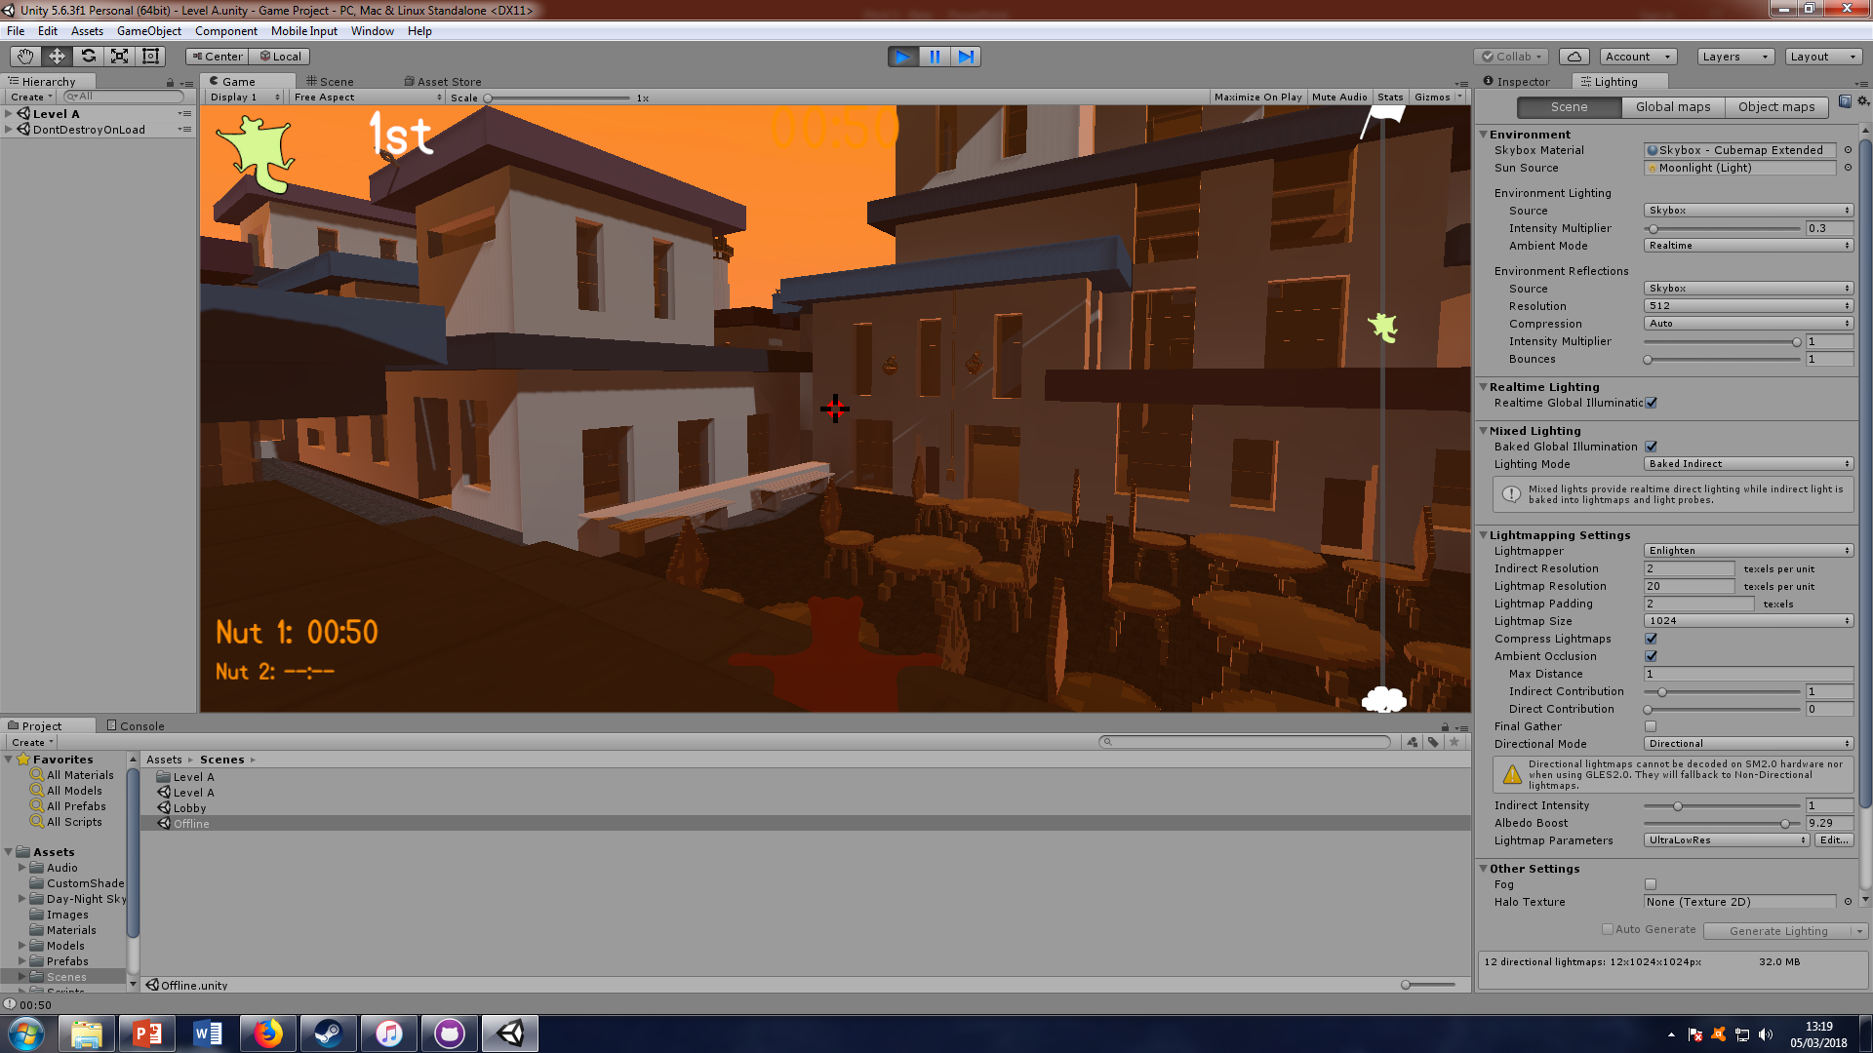
New Lighting
Notes:
Radial nut – grapple cooldown
Top left number – race position / nut status
Bar on right – level length and player progress on it
Squirrels on progress bar – players without nut
Nuts on progress bar – players with nut
Timer

Slide 7

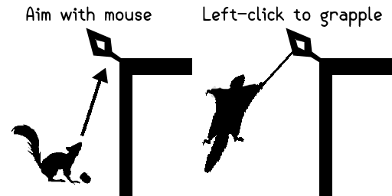
New Tutorials
Notes:
Radial nut – grapple cooldown
Top left number – race position / nut status
Bar on right – level length and player progress on it
Squirrels on progress bar – players without nut
Nuts on progress bar – players with nut
Timer

Slide 8
New UI Element

Slide 9
Changes in Action
[Gameplay Link here]

Slide 10

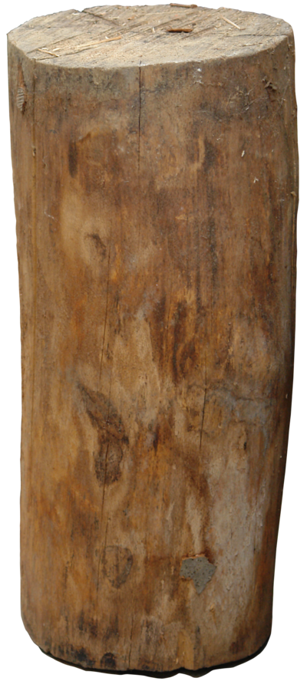
Going forward
Player character model animations
Further playtesting
Polishing mechanics
Polishing UI
Fix lighting issues

Slide 11
Questions?
Elliot Page – Max Carter – Zachari Cooper – Rebecca Brannum – Joe Wilson

